Slide 1

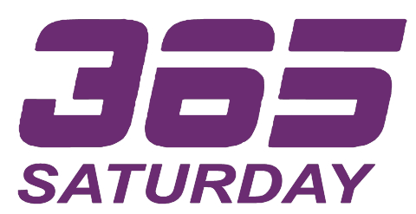
“There can be no greater gift then that of giving one’s time and energy
to help others without expecting anything in return”
– Nelson Mandela

Slide 2
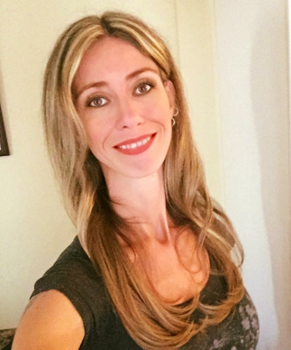


Dian Taylor
Introduction to Power Virtual Agent
Presales Engineer RSM US LLP dian.taylor@rsmus.com
https://D365Goddess.com
@D365Goddess
Search for D365 Goddess
https://www.linkedin.com/in/diantaylor/

Slide 3
Agenda
What is Power Virtual Agent
How to get started
Entities
PVA Components
Topics & Trigger Phrases
Authoring Canvas
Demos

Slide 4

What is Power Virtual Agent

Slide 5



What is Power Virtual Agent
Power Virtual Agents is Designed for Everyone
The chatbot service that enhances everyone’s experience
Your Customers
Subject Matter Experts
IT Admin/Dev

Slide 6
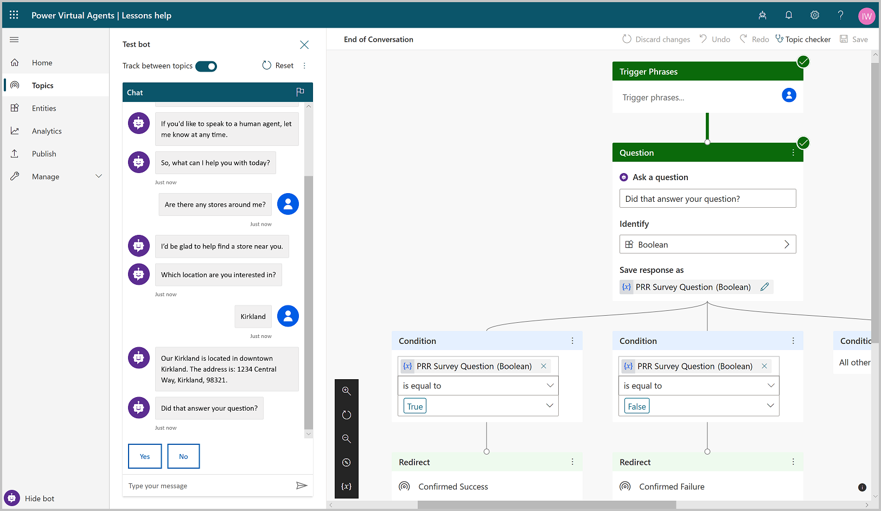
What is Power Virtual Agent
Simple, graphical bot creation Easily test and maintain bots through a simple, easy to use graphical interface
Extract information from user responses Recognize, extract and act on user’s responses.
Remember User Responses Store user information in variables for later use to create personalized converstations

Slide 7
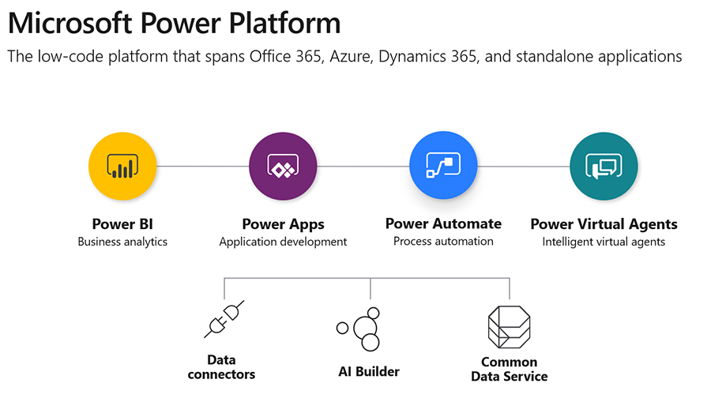
What is Power Virtual Agent

Slide 8
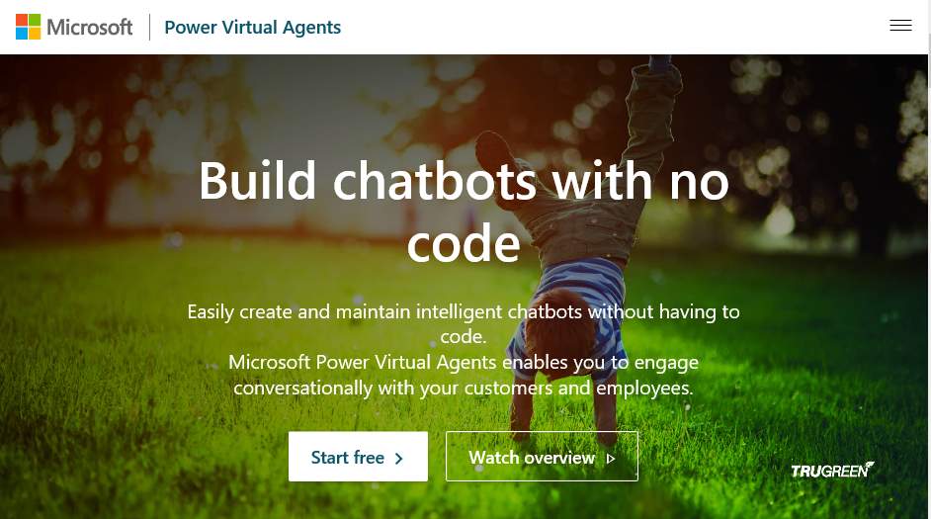
How to get started
Get a trial at https://powervirtualagents.microsoft.com
Personal email addresses not supported

Slide 9
Environments
Environment to host bot will be created
Additional environments can be created

Slide 10
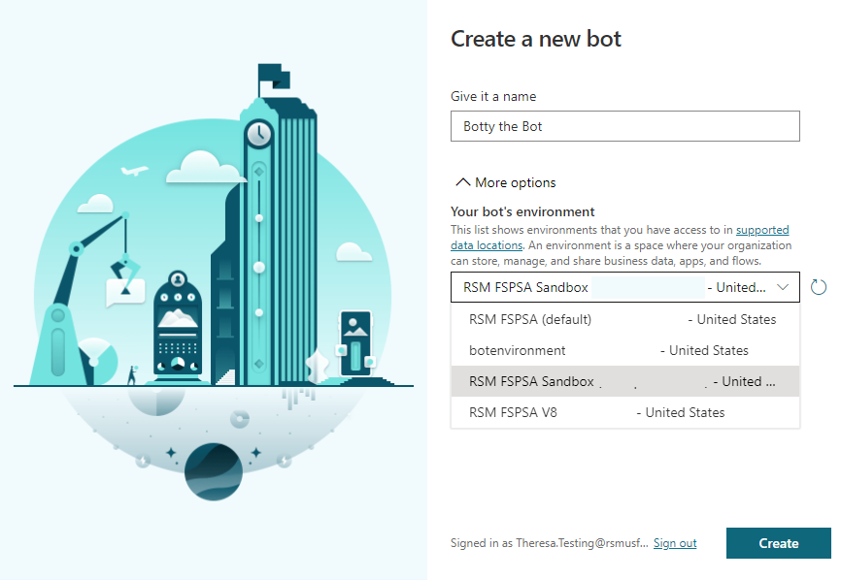
Create your first bot!
Name your bot
Select environment for the bot

Slide 11
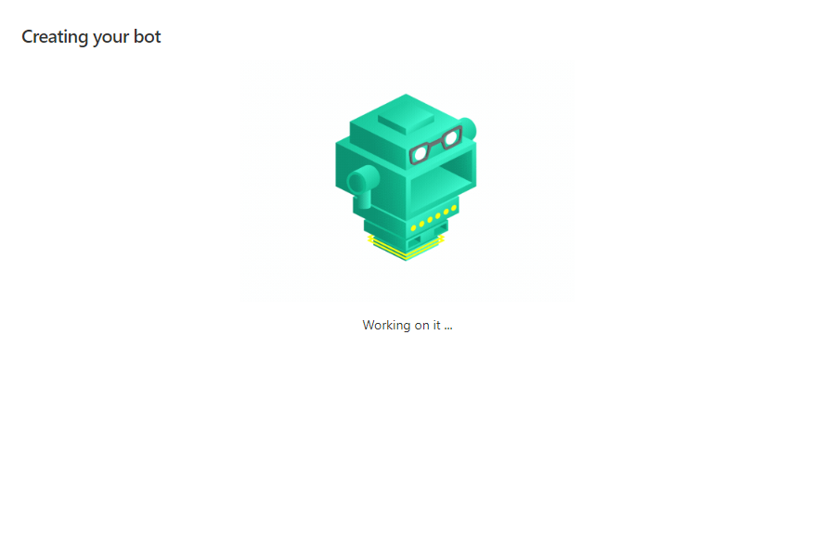
Create your first bot!
Now wait!

Slide 12
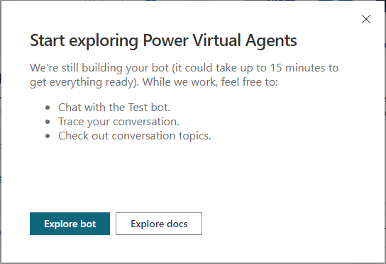
Create your first bot!
Explore PVA while your bot is being created!

Slide 13
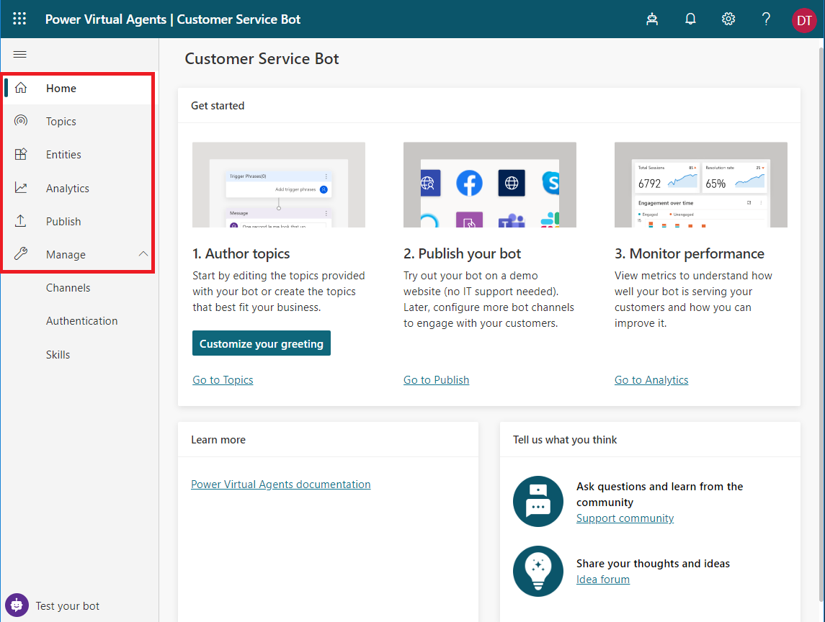
Power Virtual Agent Components
Topics
Entities
Analytics
Publish
Manage
Notes:
Power Virtual agents are made up of several components. Lets look at each individual component to see how it’s used in the application.

Slide 14
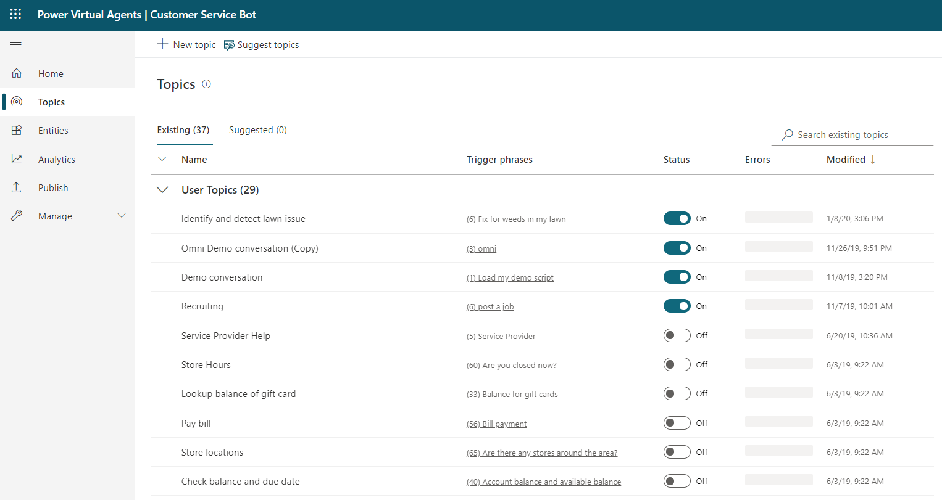
Topics
Conversation Paths
Authoring Canvas
Ability to turn on/off
Suggested Topics
Lesson Topics
Trigger Phrases

Slide 15
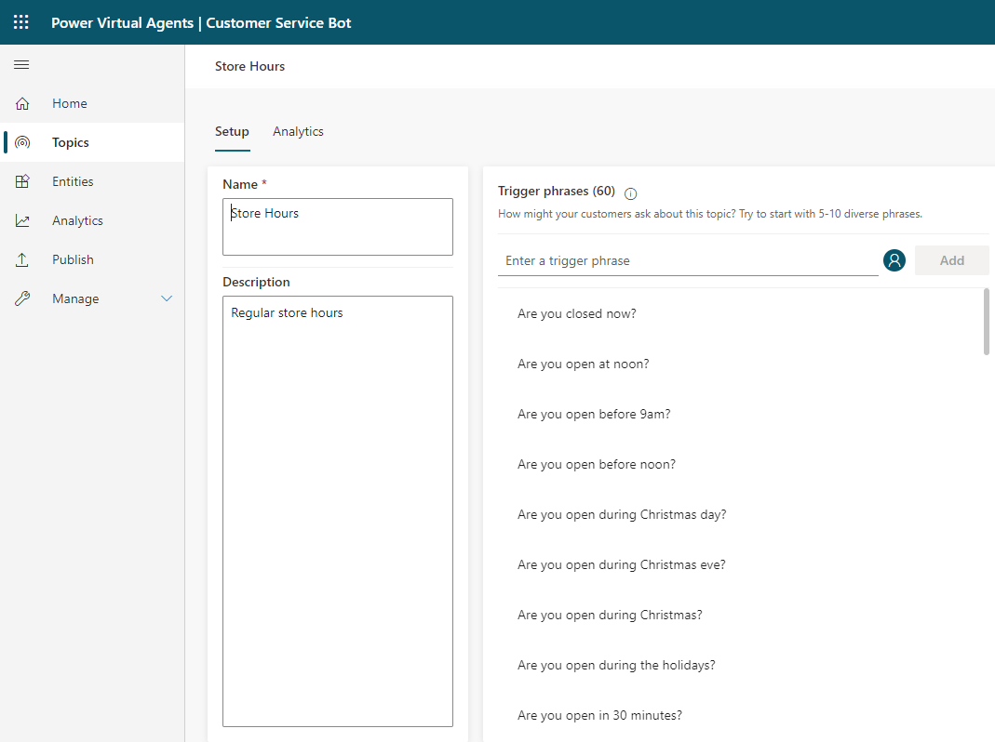
Trigger Phrases
Phrases/Keywords/Questions
Used for Topic Routing
AI

Slide 16
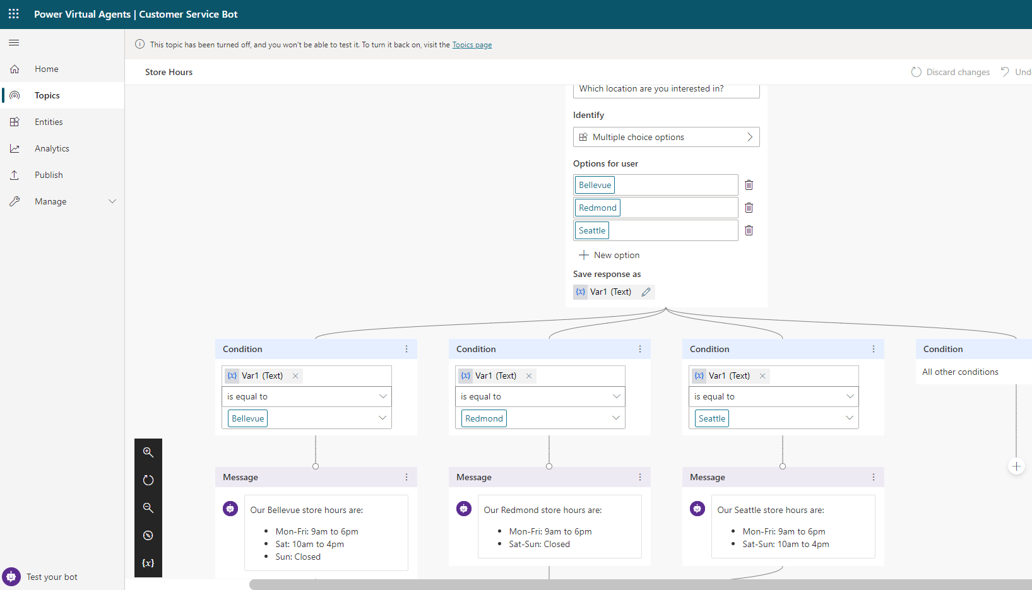
Authoring Canvas
Questions
Answers
Variables
Actions

Slide 17
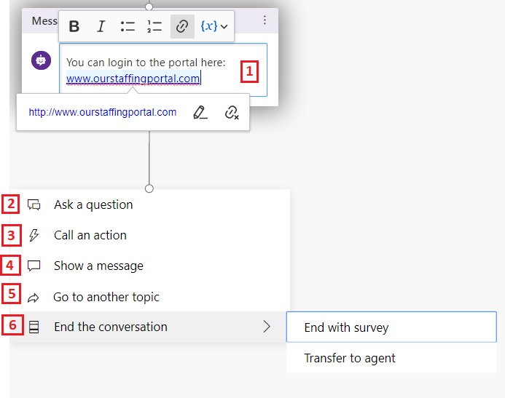
Authoring Canvas
Formatting options in PVA message or question
Question from PVA
Trigger Actions from Power Automate (aka Flow) or Bot Skills
Show a message to user
PVA will redirect to another topic
Ends the conversation

Slide 18

Demo #1

Slide 19
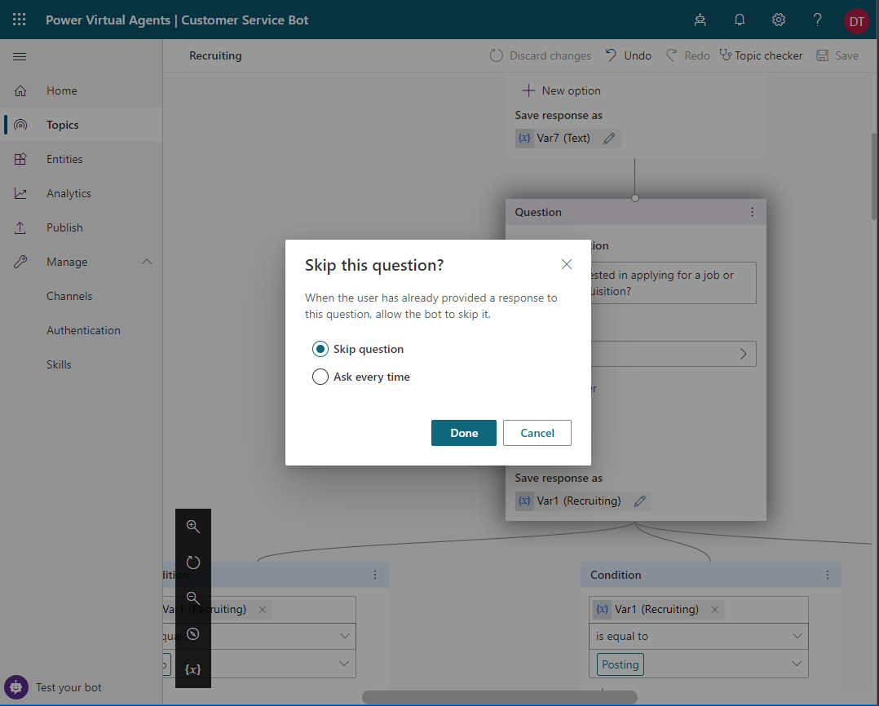
What is Power Virtual Agent
Avoid Repetitive Conversations Allow the bot to skip questions that have already been answered earlier in the conversation

Slide 20
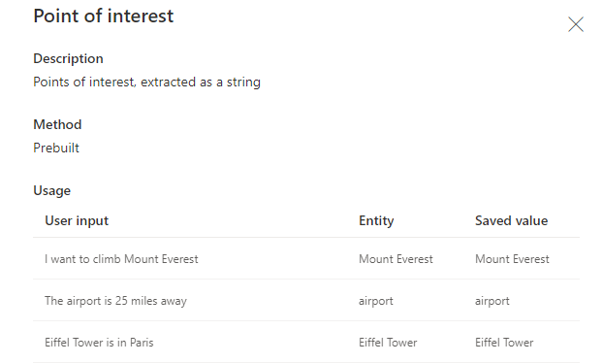
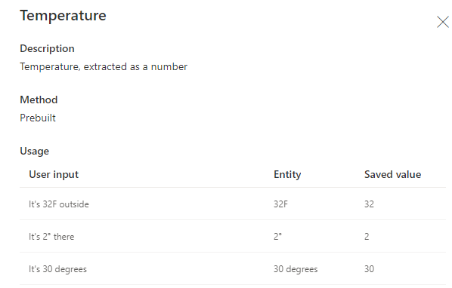
Entities

Slide 21
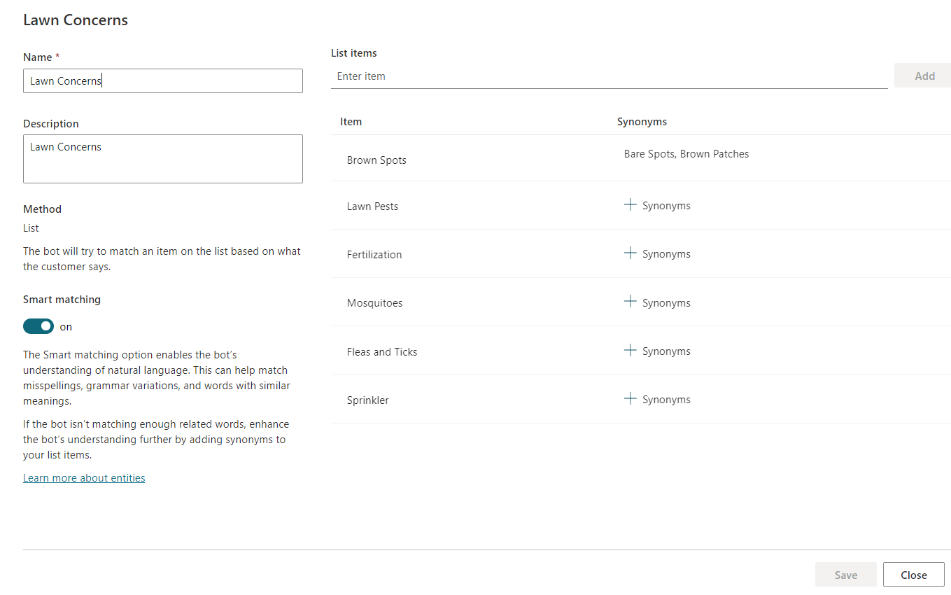
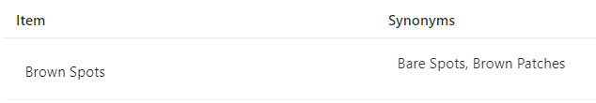
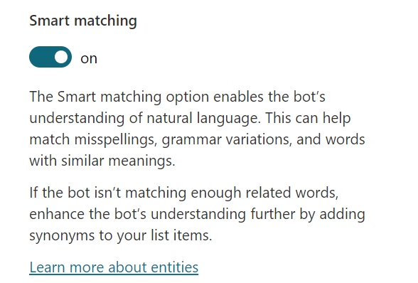
Entities
Smart Matching
Synonyms

Slide 22
Demo #2

Slide 23
Create Personalized Customer Experiences
Enable your bot to act on behalf of your customer
Skip questions if the information has already been given by the user
Hand-off to D365 Omnichannel for Customer Service
Handoff to generic live-chat provider.

Slide 24
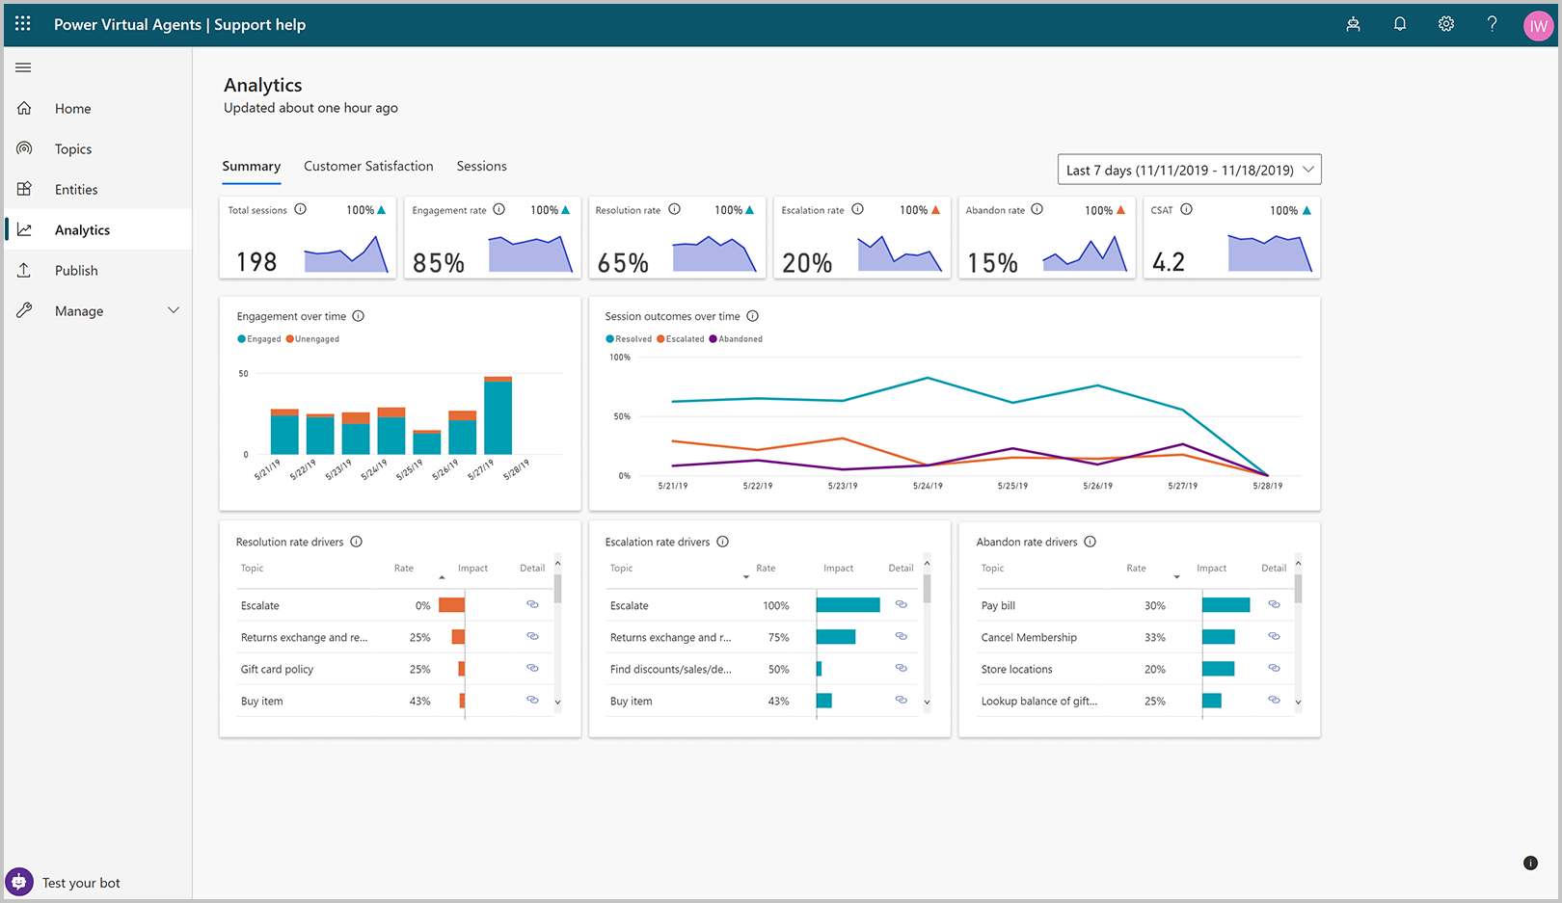
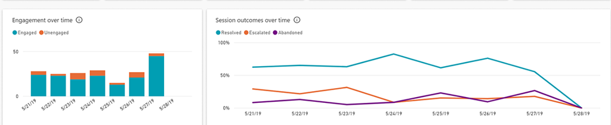
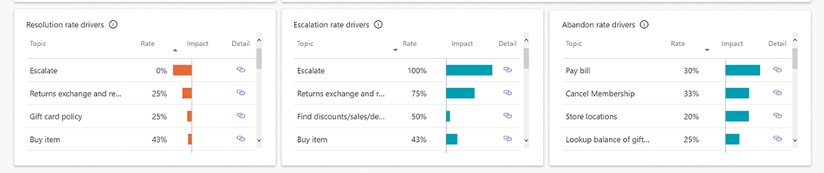
Analytics

Slide 25
Demo #3

Slide 26
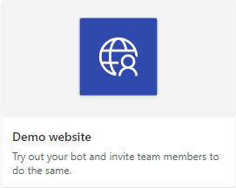
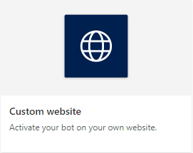
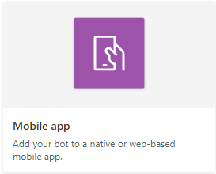
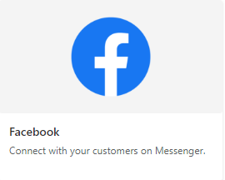
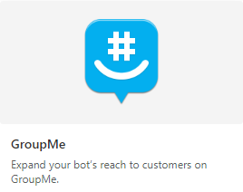
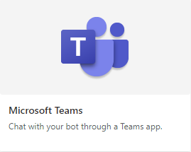
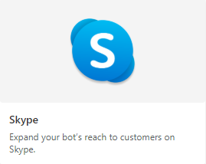
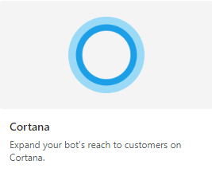
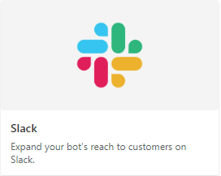
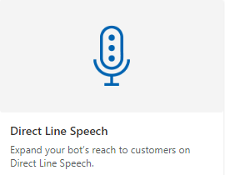
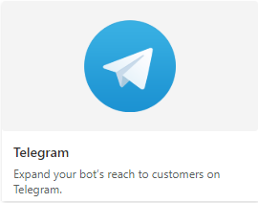
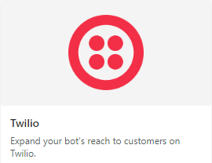
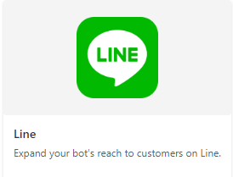
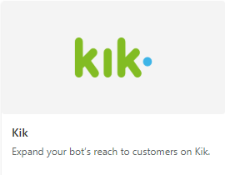
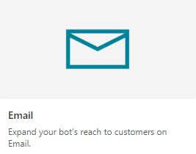
Publish your bot

Slide 27
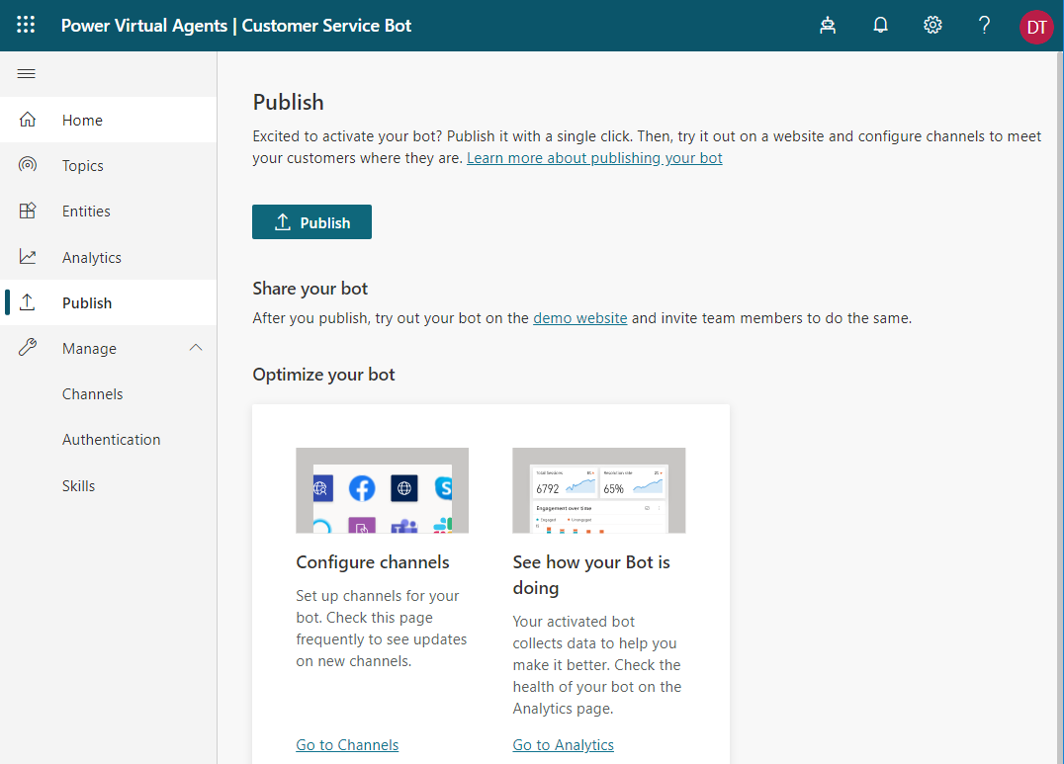
Demo Website
Try out the bot
Share with your team to test
Not for production

Slide 28
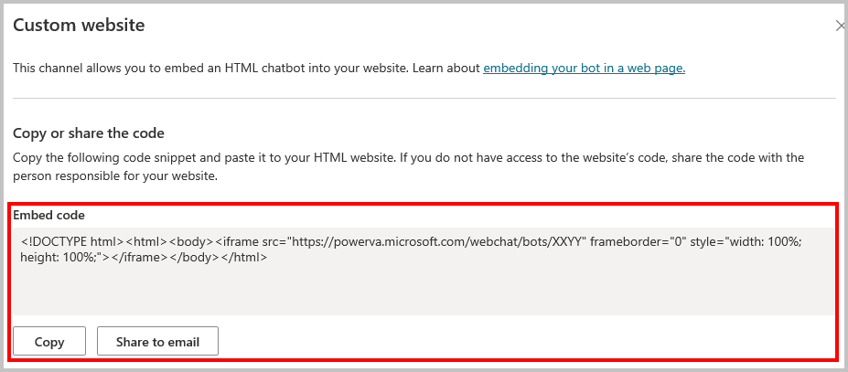
Website
Iframe
Customer facing or internal facing (I.E SharePoint)
Power Apps Portal
Custom Portal

Slide 29
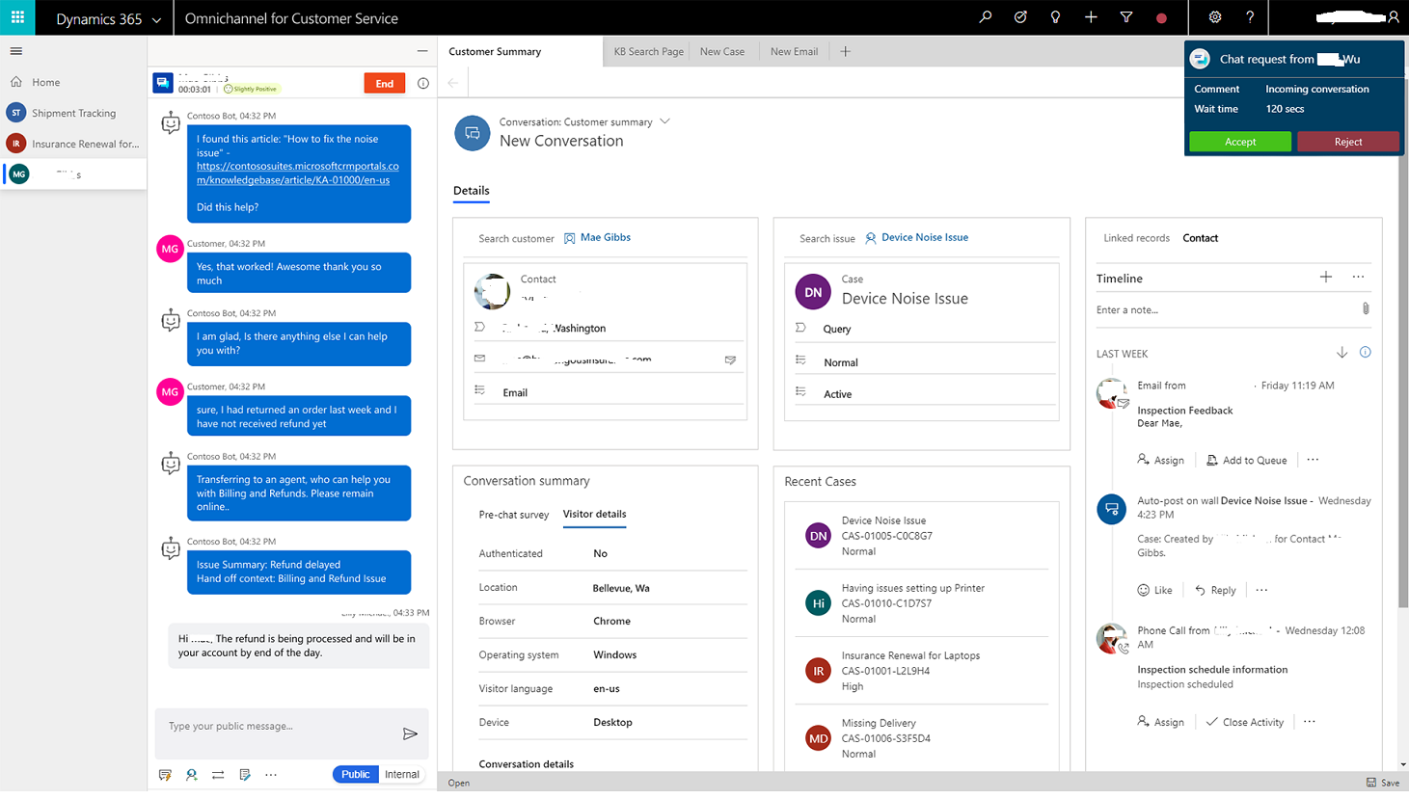
Omnichannel for Customer Service integration
Omnichannel is Microsoft add-on to D365 Customer Service
Seamless Integration
Handoff to live agents

Slide 30
Publish Bot

Slide 31
Manage
Channels
Authentication
Skills

